Slide 1
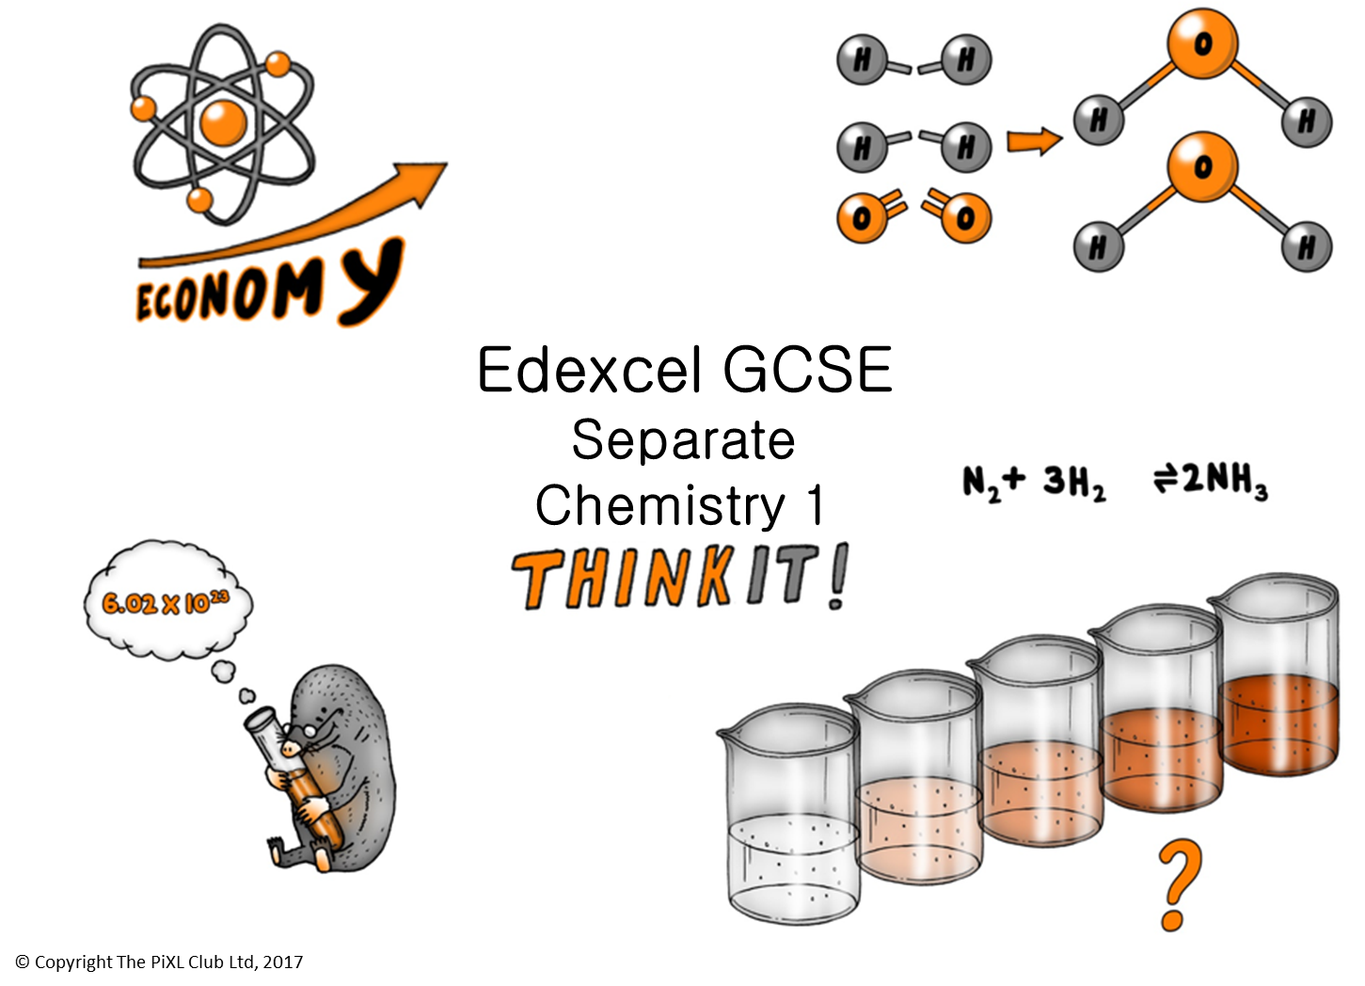

Slide 2
Moles of Solutions and Gases:
Explain how the concentration of a solution in mol/dm³ is related to the mass of the solute and the volume of the solution.
The formula of butane is C₄H_{10.}. Calculate the volume of 11.6 g of butane gas at RTP.
Explain why it can sometimes be difficult to calculate the volume of a gas.
Concentration of Solutions:
0.5 mol of solute is dissolved in 250 cm³ of solution. Calculate its concentration.
Calculate the concentration for 2.925x10⁻⁴g of sodium chloride in 5cm³ of water.
Fire crews will often attend accidents involving chemical containers to hose down chemical spills. Explain why.
Reversible reactions and equilibrium
Write a balanced symbol equation for the reversible reaction when nitrogen gas reacts with hydrogen gas to make ammonia gas.
What would you need to do to ensure that the above reaction could reach equilibrium?
Mole:
Describe what is meant by the term “mole”.
Explain how to calculate how many moles there are in 9.6g of sulfur.
3.2g of iron oxide reacts with 16.2g of aluminium to produce aluminium oxide. Describe how to calculate the maximum mass of iron that could be collected at the end of the experiment, and why this mass is not collected.
16.2g of aluminium reacts with 32.0g of iron(III) oxide to produce iron metal and aluminium oxide. Explain why iron oxide is the limiting factor.
Atom Economy and percentage yield:
Calculate the atom economy in the production of iron in the blast furnace.
Ethanol can be produced by fermentation or by hydration of ethene. Compare their atom economy and evaluate which method is best for making ethanol.
A company processes 200 tonnes of limestone a day. It collects 98 tonnes of calcium oxide for manufacturing. Calculate the percentage yield and explain why this reaction does not have a 100% yield production.
Edexcel GCSE Separate Chemistry 1
ThinkIT!
© Copyright The PiXL Club Ltd, 2017
Cells and Fuel Cells:
Hydrogen fuel cells are used in some buses, but are not yet used in cars. Discuss why this is the case.
Hydrogen is sometimes described a "perfect fuel" evaluate this statement.
Describe what happens at the electrodes in a fuel cell, giving the half equations.
Transition metals and alloys:
State the typical properties of transition metals.
Explain why the transition metals form ions with different charges.
Discuss the economic advantages of the transition metals as catalysts.
Use diagrams to explain how alloying improves the usefulness of metals and how strength is increased in terms of structure.
Corrosion and it’s prevention:
Explain how iron can be stopped from rusting.
Explain what is meant by sacrificial protection.
Corrosion is the oxidation of metals. Explain why oxidation of aluminium does not result in rusting.

